Slide 1

Entrance Training of SUSTAINABILTY MANAGEMENT
İÇDAŞ A.Ş.
Sustainability Management Unit Release Date:10.10.2018
Review Date: 10.04.2026

Slide 2


Aim and Content
Through this training presentation, it was aimed to promote sustainability and give information about our company's activities in the field of sustainability to our stakeholders

Slide 3

What is Sustainable Development?
"Development that meets the needs of the present without compromising the ability of future generations to meet their own needs."

Slide 4
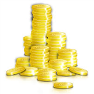


Sustainable Development= 3P
Sustainable Development
Economic Growth
(PROFIT)
Protecting the Environment
(PLANET)
Social
Development
(PEOPLE)

Slide 5
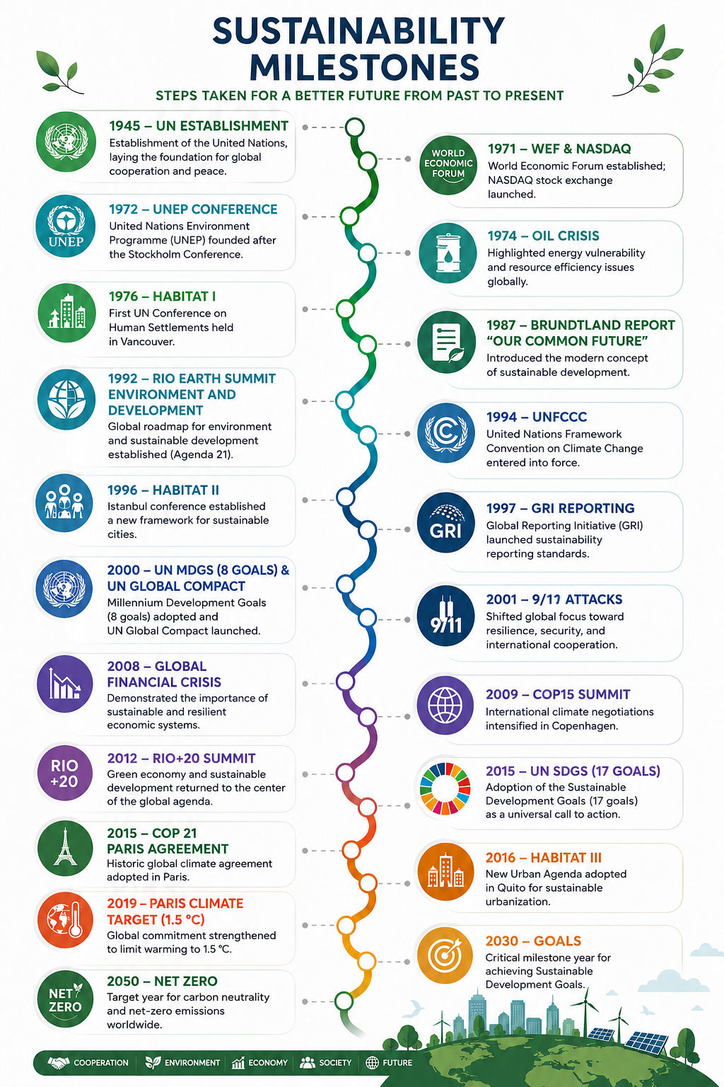
12,000 participants from 145 countries

Slide 6

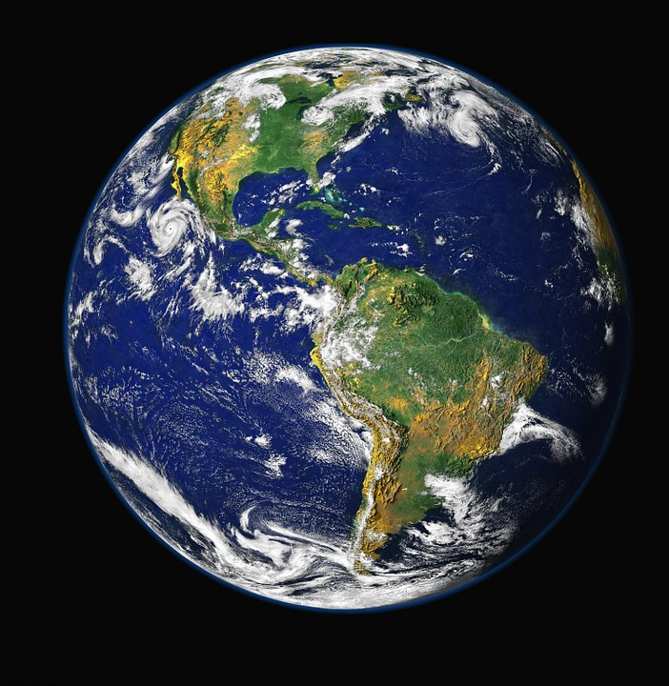
Why?
RESOURCES
POPULAT ION
Notes:
Çünkü nüfus hızla artıyor.
2030’da dünya nüfusunun 8.5 milyar kişiye ulaşması bekleniyor.
Buna karşılık doğal kaynaklar ise hızla tükeniyor.
İnsanların 1 yılda tükettiği kaynakları, dünya 2 yılda yenileyebiliyor.
Dünyadaki herkes...Ortalama bir Avrupalı gibi yaşasa... 2050’de yaklaşık 3 dünyaya ihtiyacımız olacak!!!
Bu da tabii beraberinde pek çok küresel sorunu getiriyor.
İklim değişikliği, su kıtlığı, enerji kaynakları, atık, gıda güvenliği, insan hakları ve çalışma koşulları vb...

Slide 7
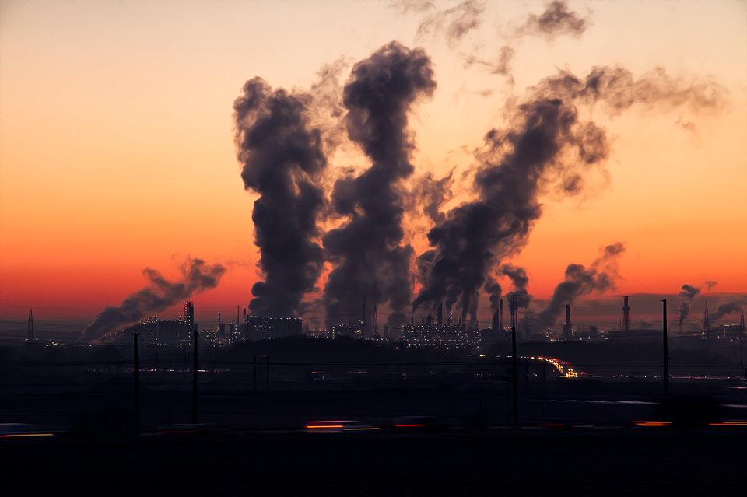
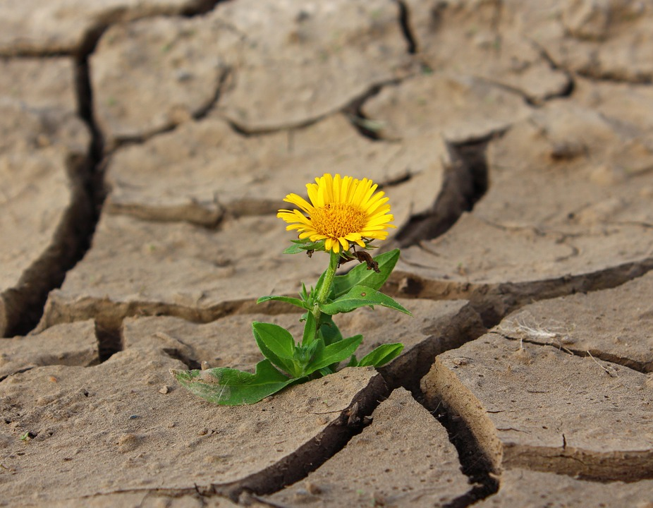
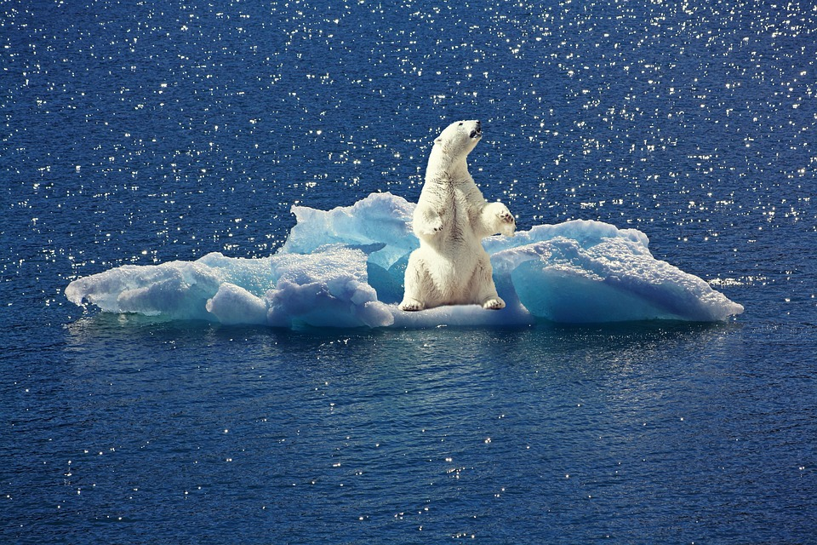
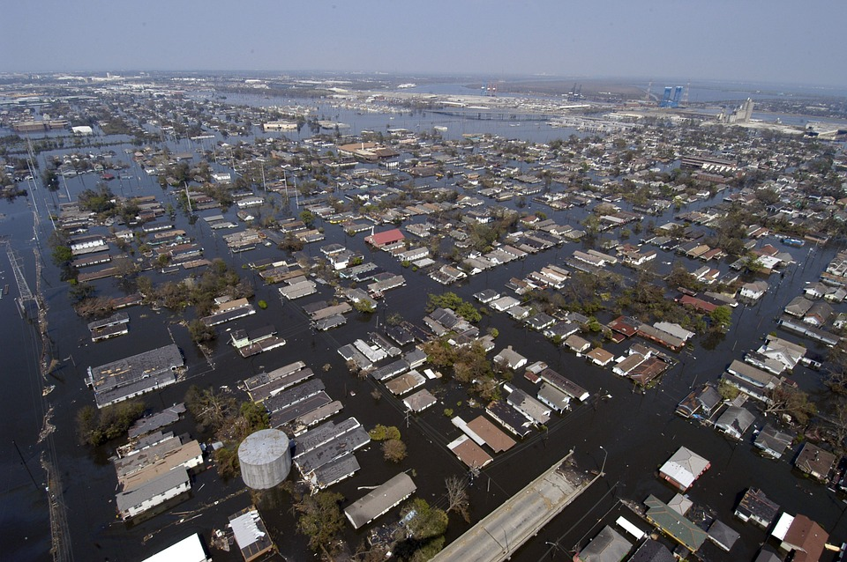
Global Issues: Climate Change
Greenhouse gases accumulate in the atmosphere as a result of burning fossil fuels used in heating, transportation and industrial processes is causing global climate change. Other human activities such as land use and deforestation accelerate climate change.
Climate Change Scenario Result
Between 1990-2100 years, is predicted to increase by 1,4 - 5,8°C

Slide 8
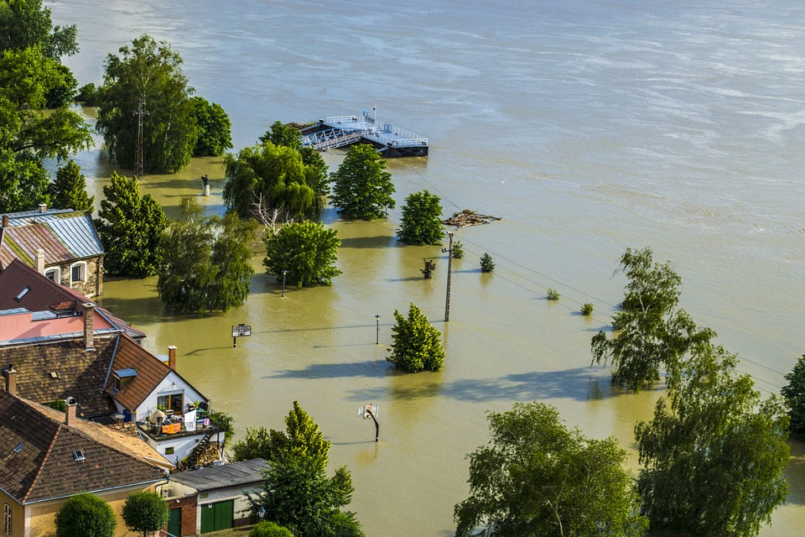
Climate Change
Climate change may cause heavy rainfall.
Notes:
ID #1444

Slide 9
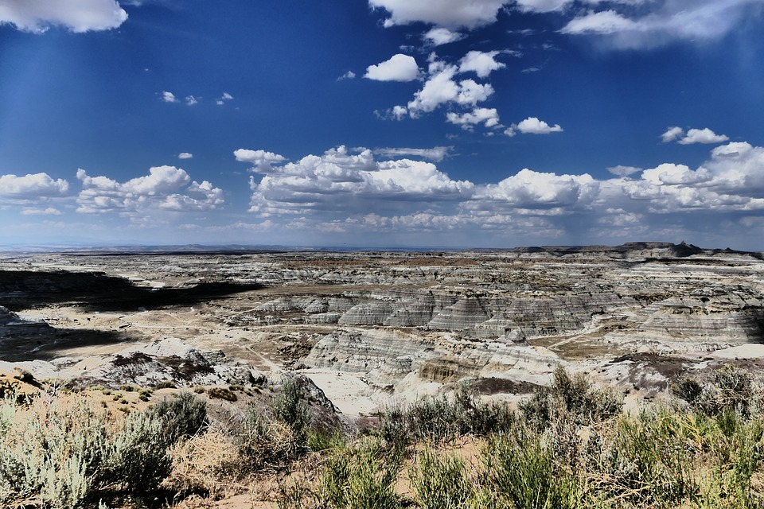
Climate Change
Climate changes cause droughts..
Notes:
ID #916

Slide 10
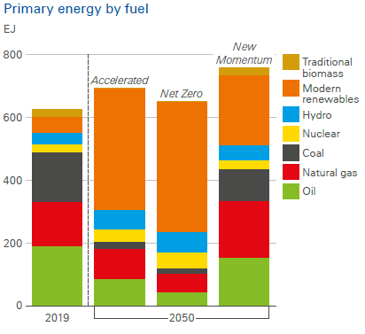
World Energy Consumption
Very little of the world's energy consumption comes from renewable energy sources. Natural resources are rapidly consumed.
^{BP Energy Outlook –} ^{2022 edition}

Slide 11
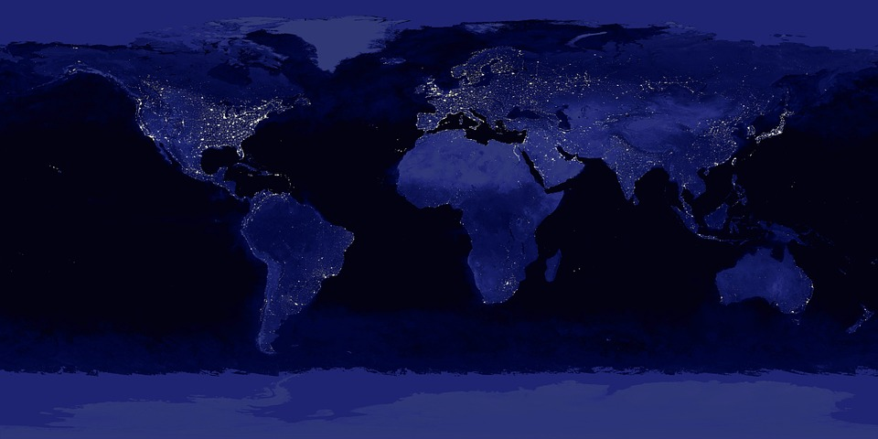
World Energy Consumption
This photo taken from the satellite shows where the world's electricity energy is concentrated.

Slide 12
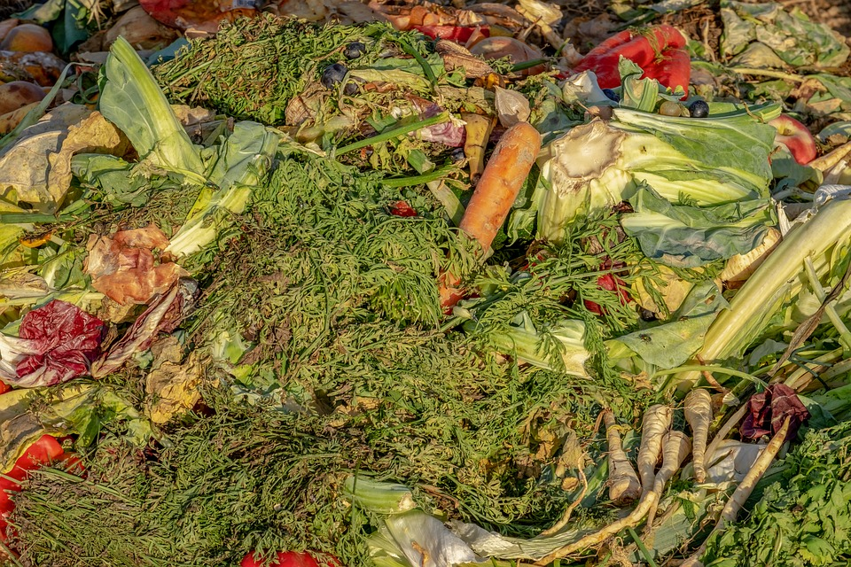
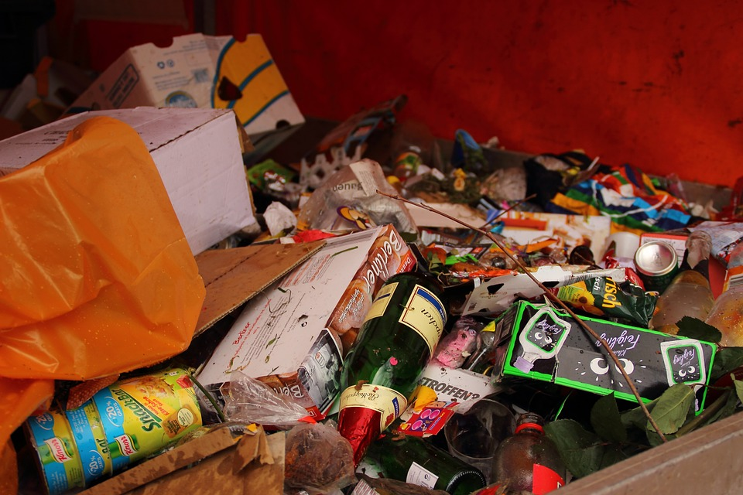
Global Issues: Food Safety
One of the biggest problems in the world that its population has exceeded 8 bilolion is Food Safety.
- 870 million people a year are undernourished.
- According to the United Nations Food and Agriculture Organization (FOA), 1.3 billion tons of food is wasted.
Projects should be developed and supported to reduce food waste and squander in worldwide.

Slide 13
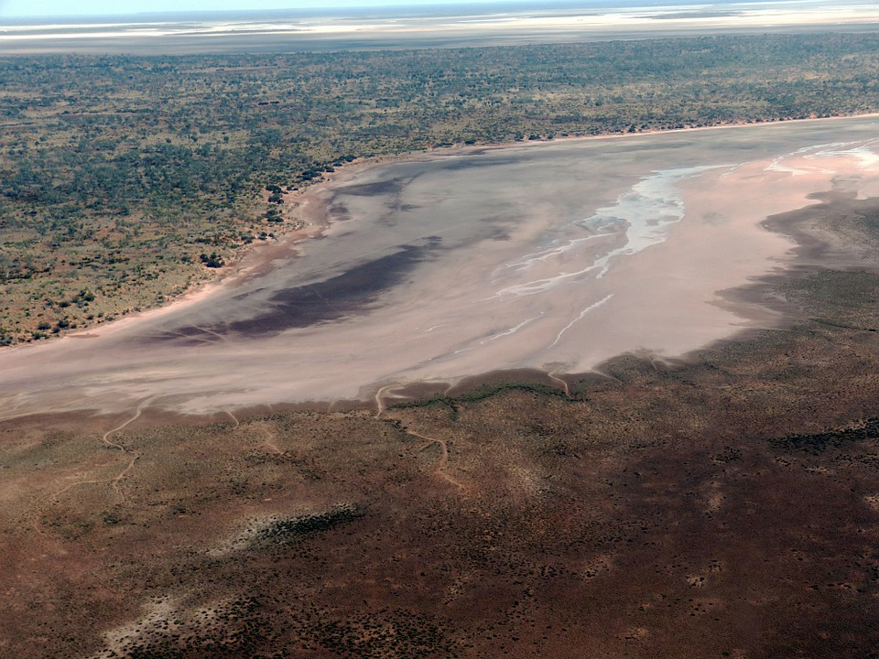
Global Issues: Water Security
Water security has been defined as "the reliable availability of an acceptable quantity and quality of water for health, livelihoods and production, coupled with an acceptable level of water-related risks"

Slide 14
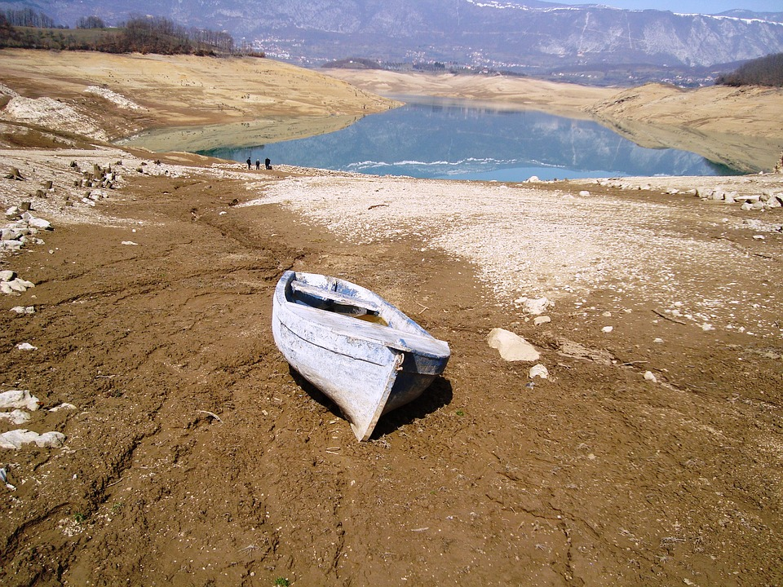
Global Issues: Water Security
Drought is an important Water Safety component.

Slide 15
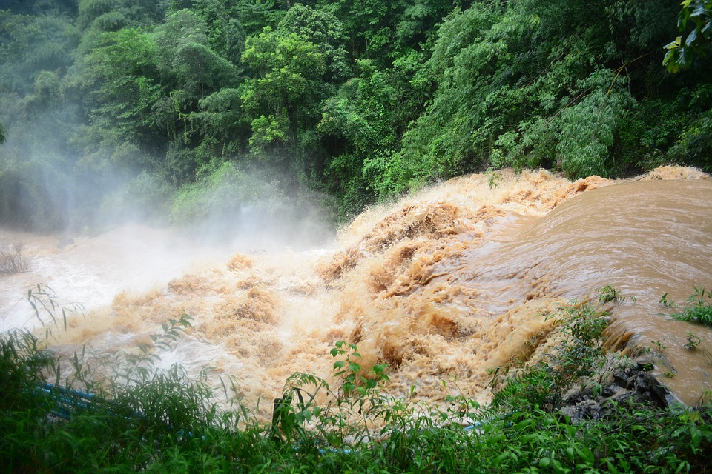
Global Issues: Water Security
Apart from drought, the floods is also an important water safety factor that negatively affects people's lives.

Slide 16
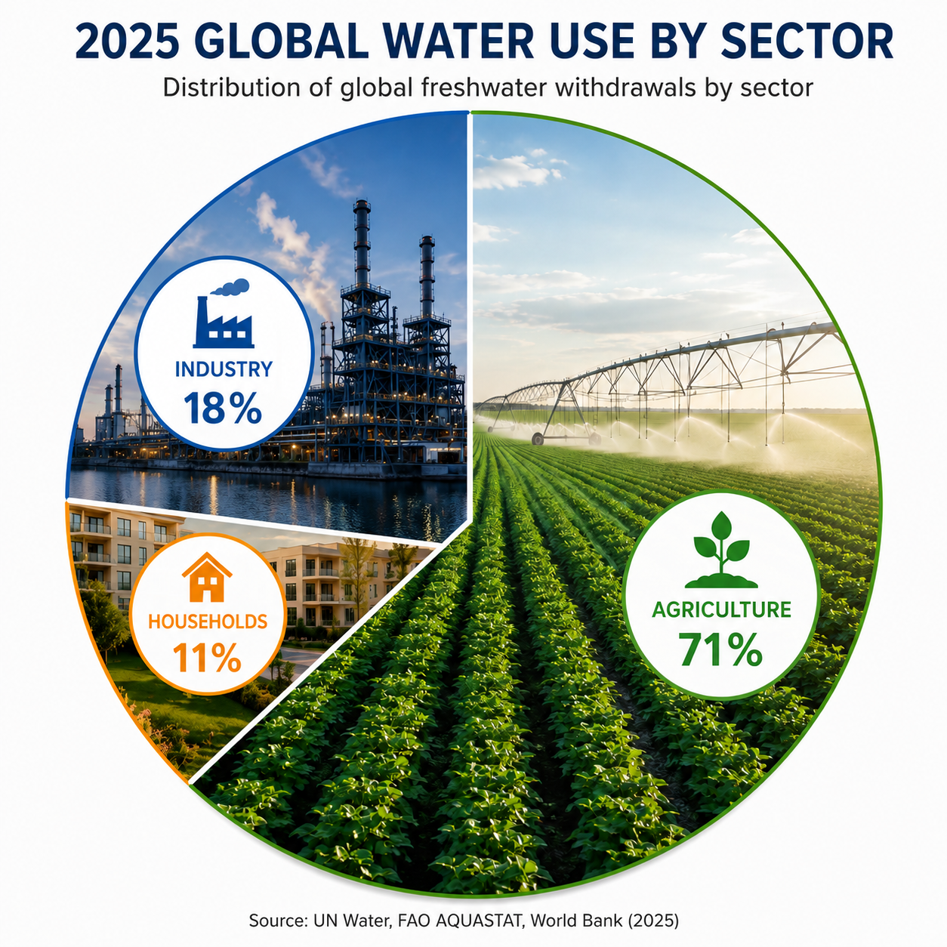

Slide 17

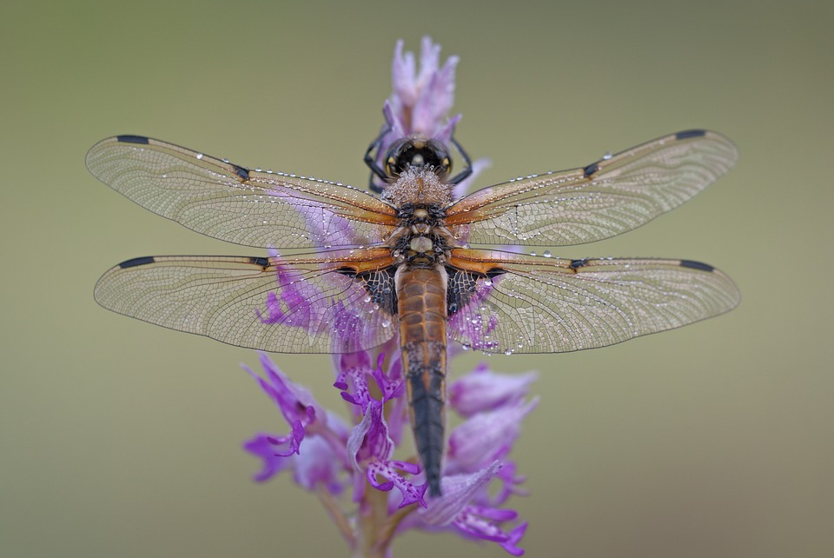
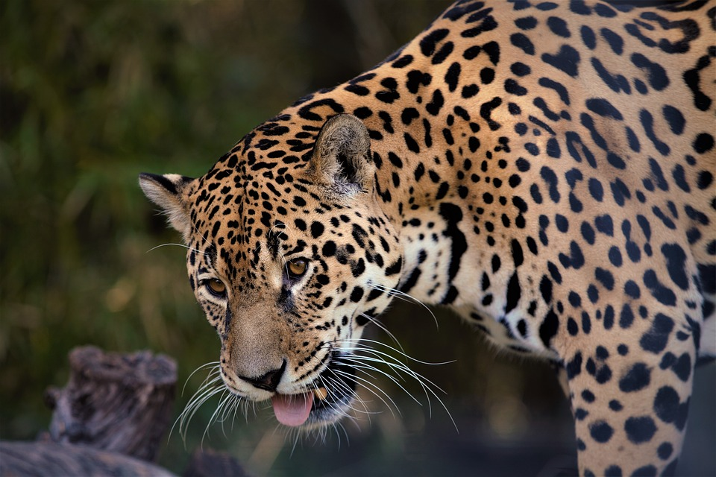
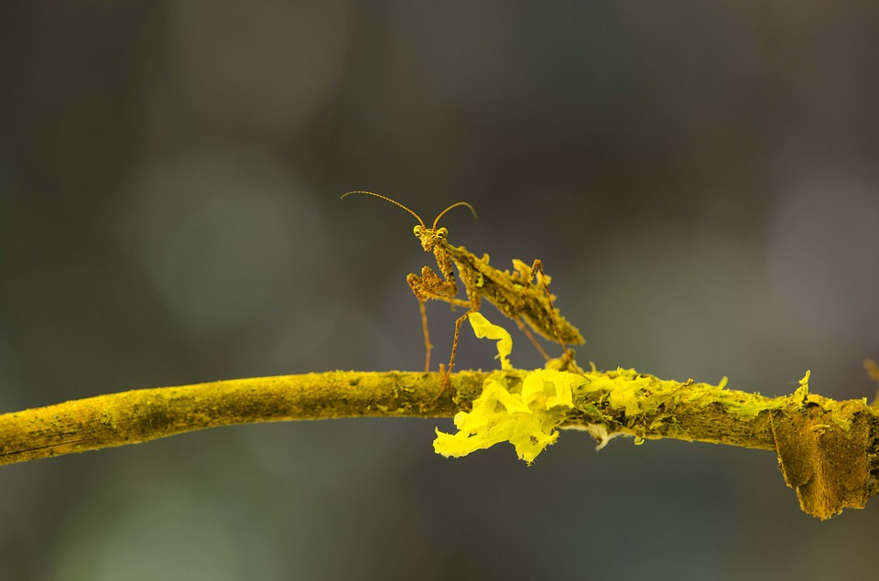
BIODIVERSITY

Slide 18


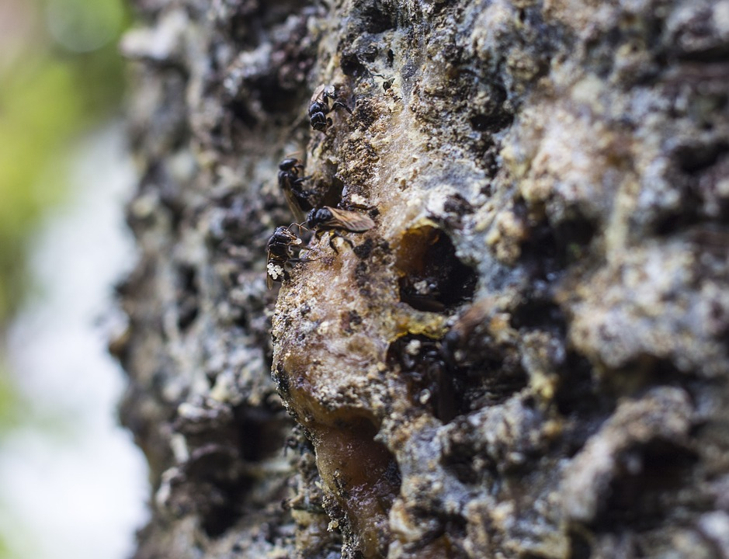

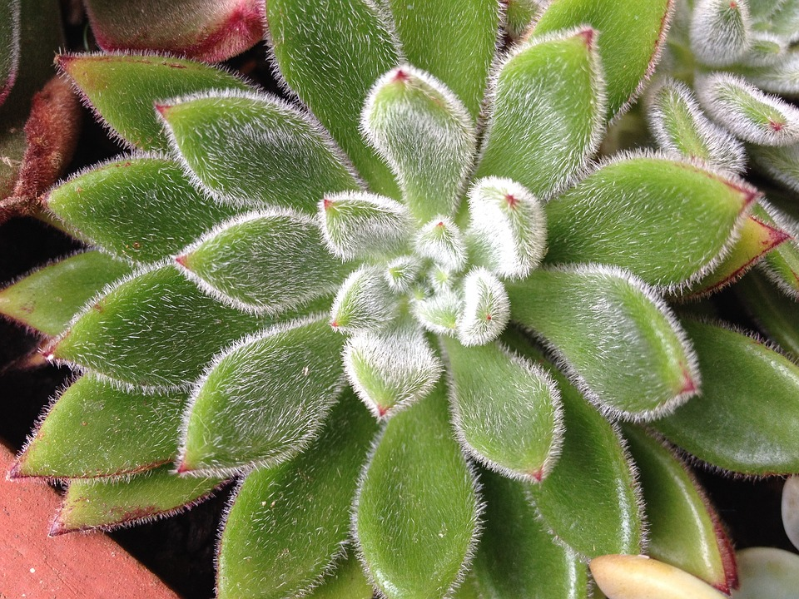
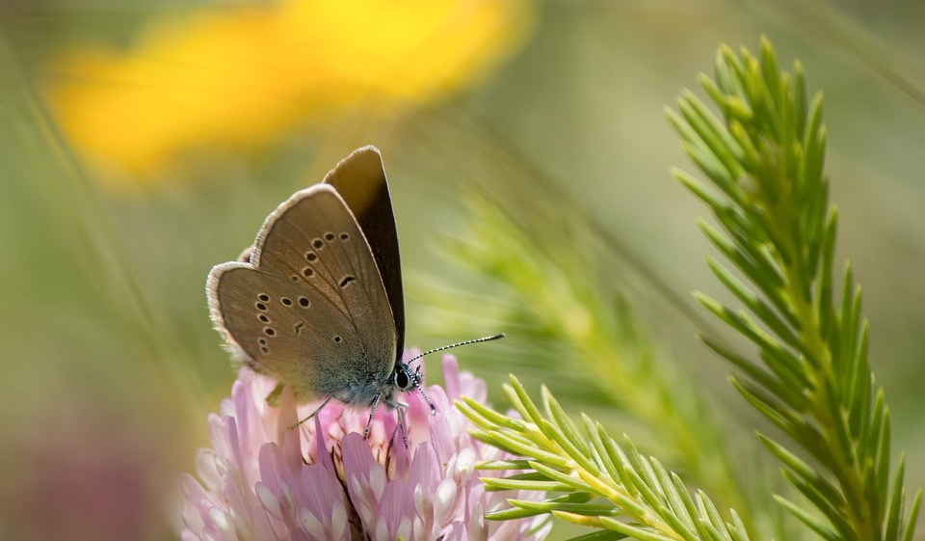
Global Issues: Decreasing of Biodiversity
All the creatures in the ecosystem are connected to one another. Many life species including humans are negatively affected by decrease in species.

Slide 19
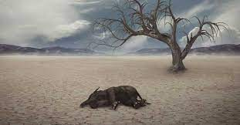
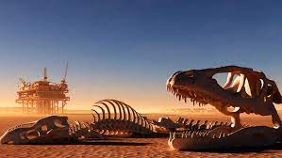
Mass Extinction.
They are referred to as periods in world history when a large number of unusual species disappeared at the same time or in a limited period of time.
There have been 5 mass extinctions in the world.
According to the studies, the 6th mass extinction caused by human beings, the Anthropogenic period started.

Slide 20
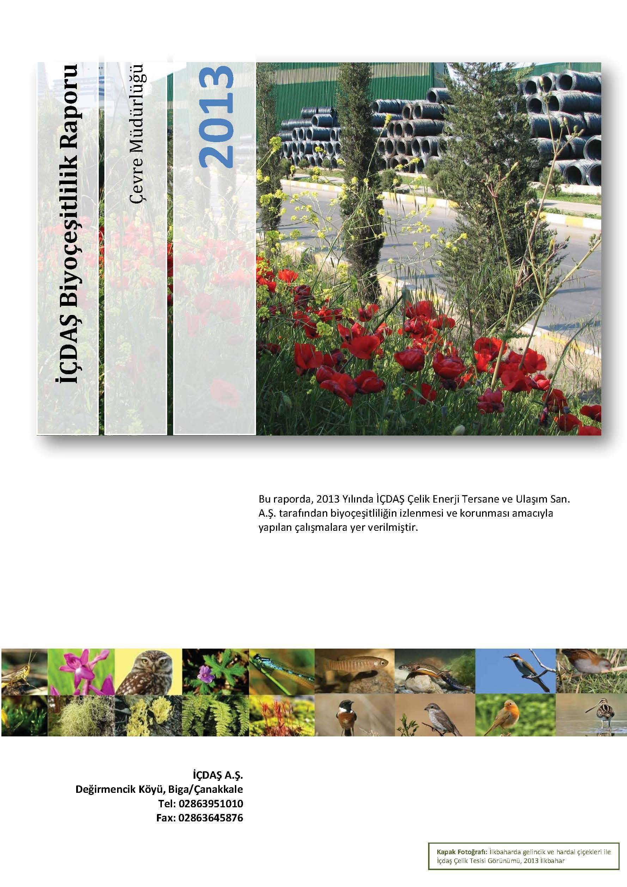
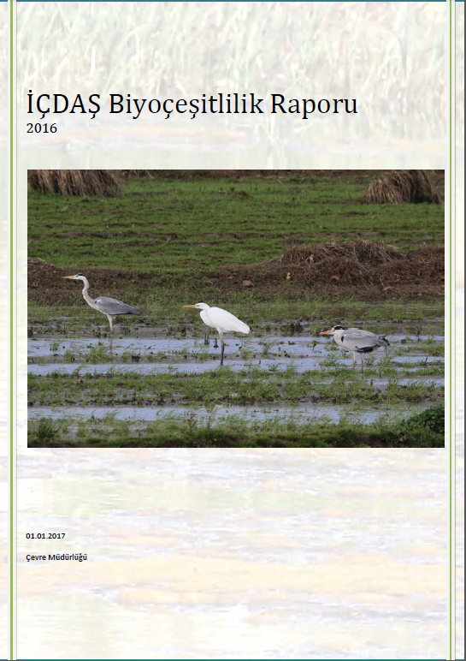
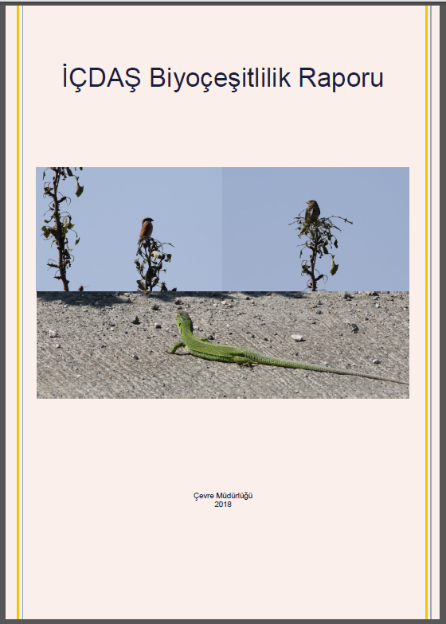

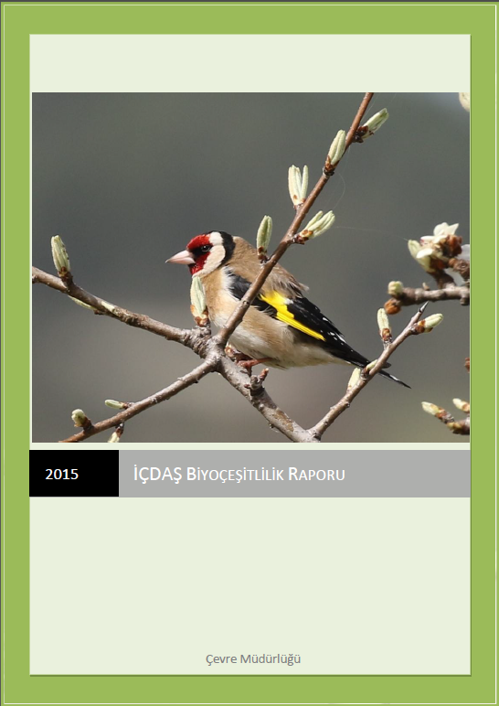
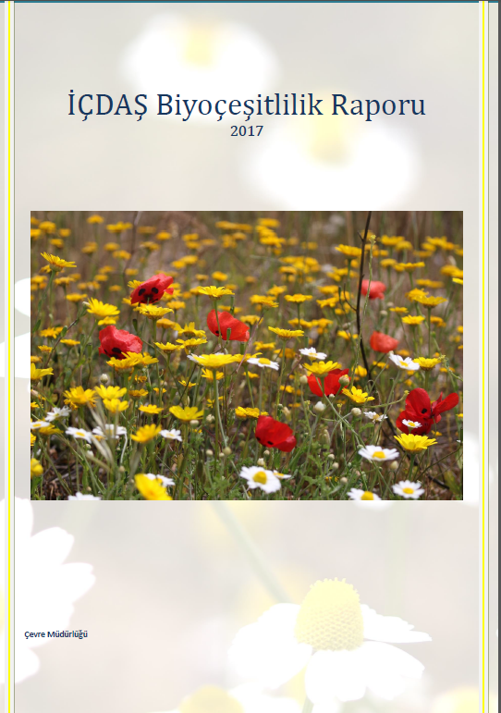
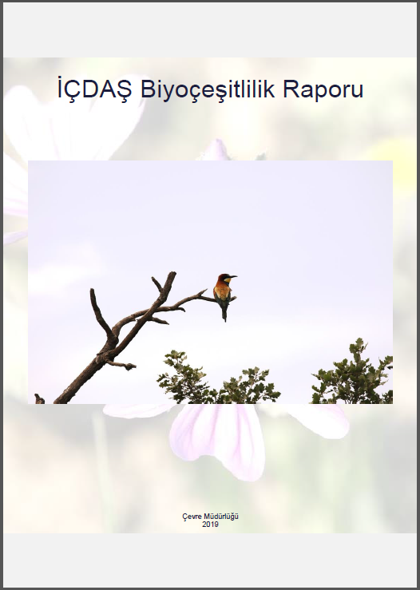
Biodiversity Reports
Since 2013, we have been monitoring the biodiversity around our facilities. Our biodiversity studies are published on our website.
https://www.icdas.com.tr/pages/8925/2716/f/tr-TR/Biyocesitlilik_Calismalari.aspx

Slide 21
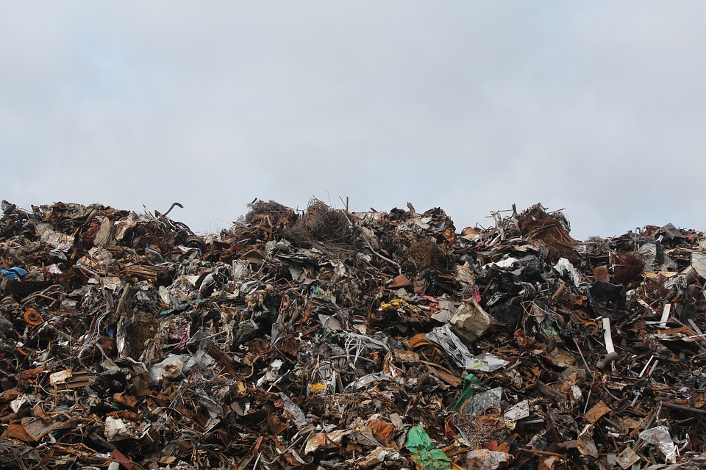
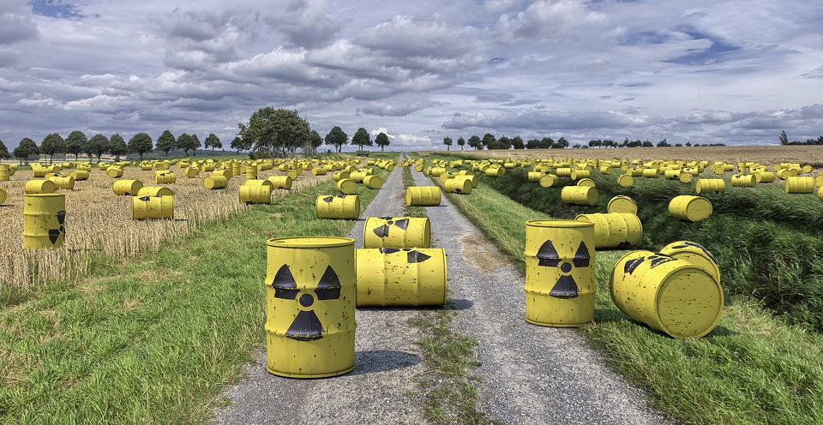
Global Issues: Wastes
Waste generates significant amounts of emissions as well as causing pollution both in the environment and in water resources.

Slide 22
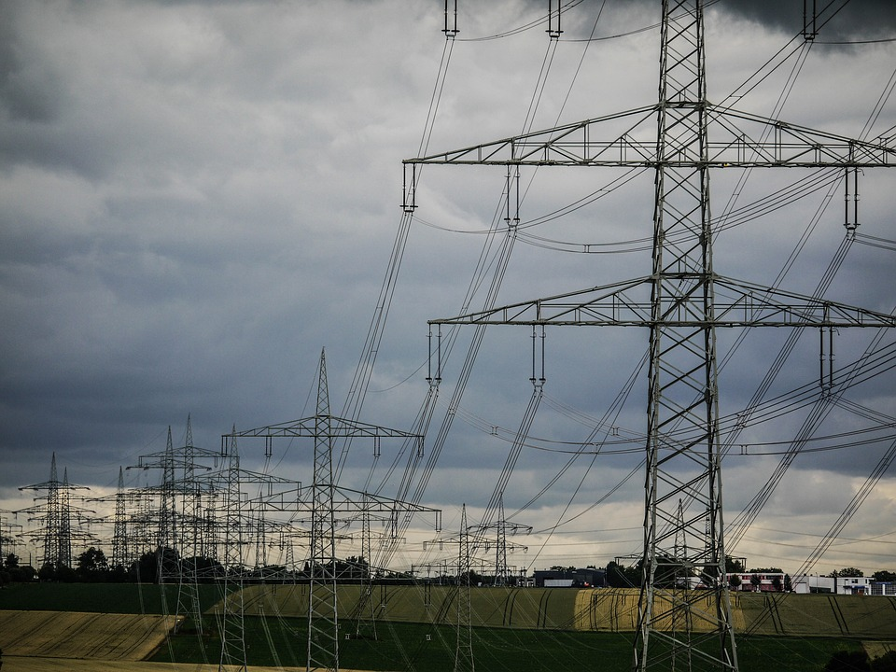
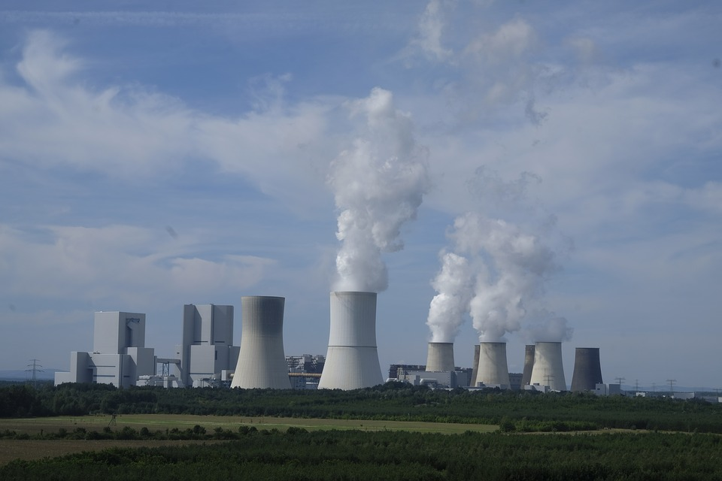
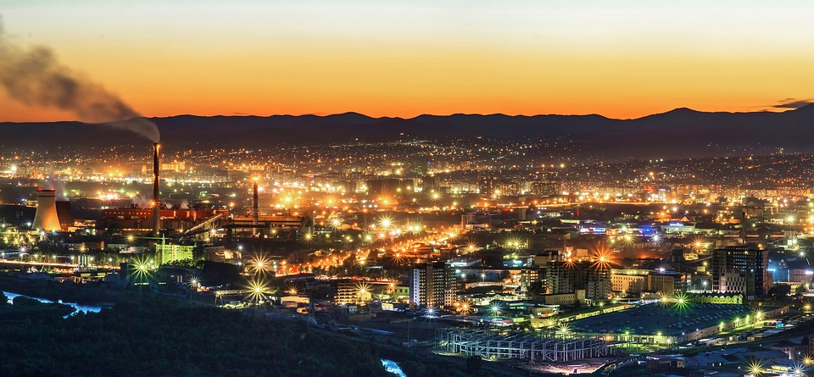
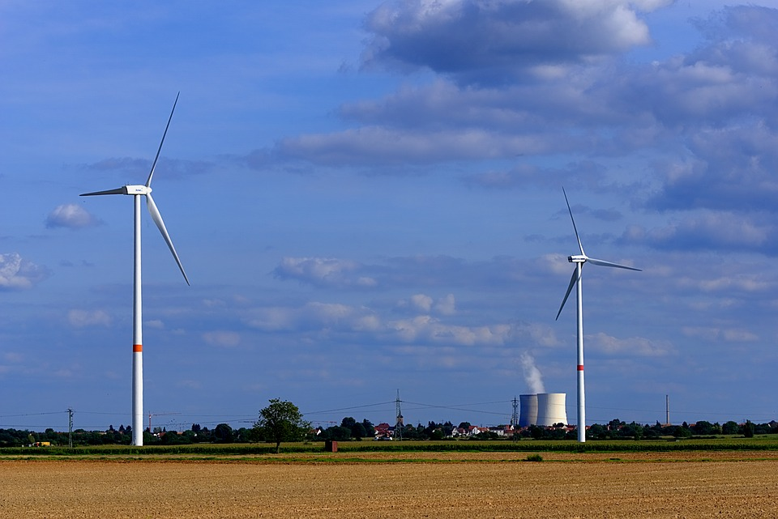
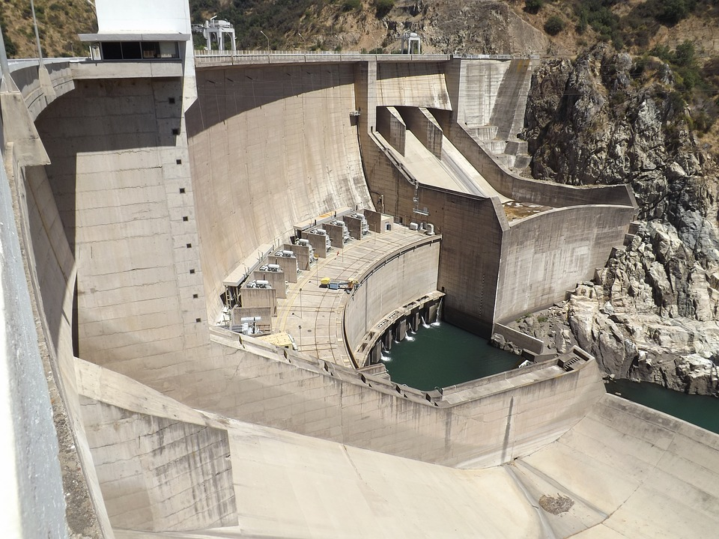
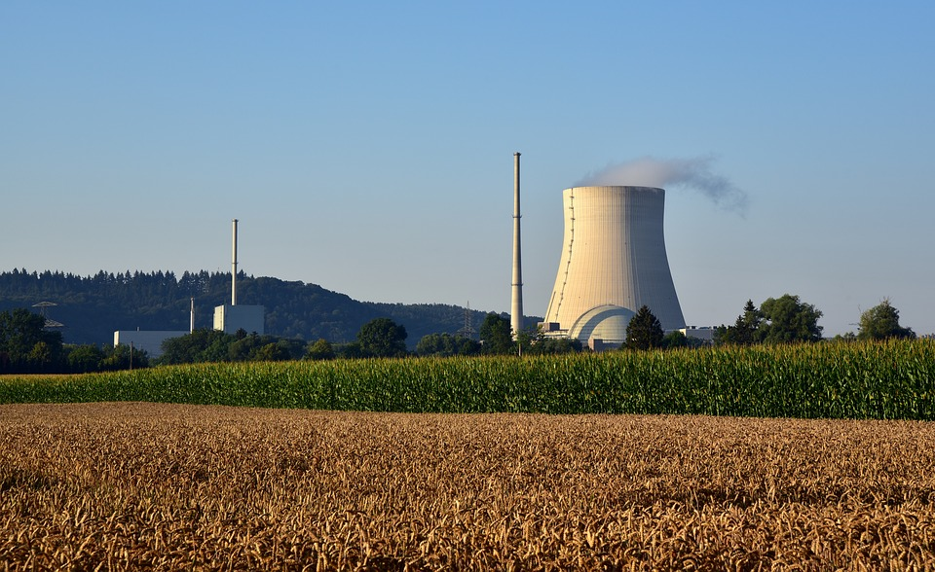
Global Issues: Energy Security
Energy security; It is expressed as continuous consumption of energy in clean and in various appropriate quantities and with high efficiency. Turkey is dependent on external sources to meet its energy needs.

Slide 23
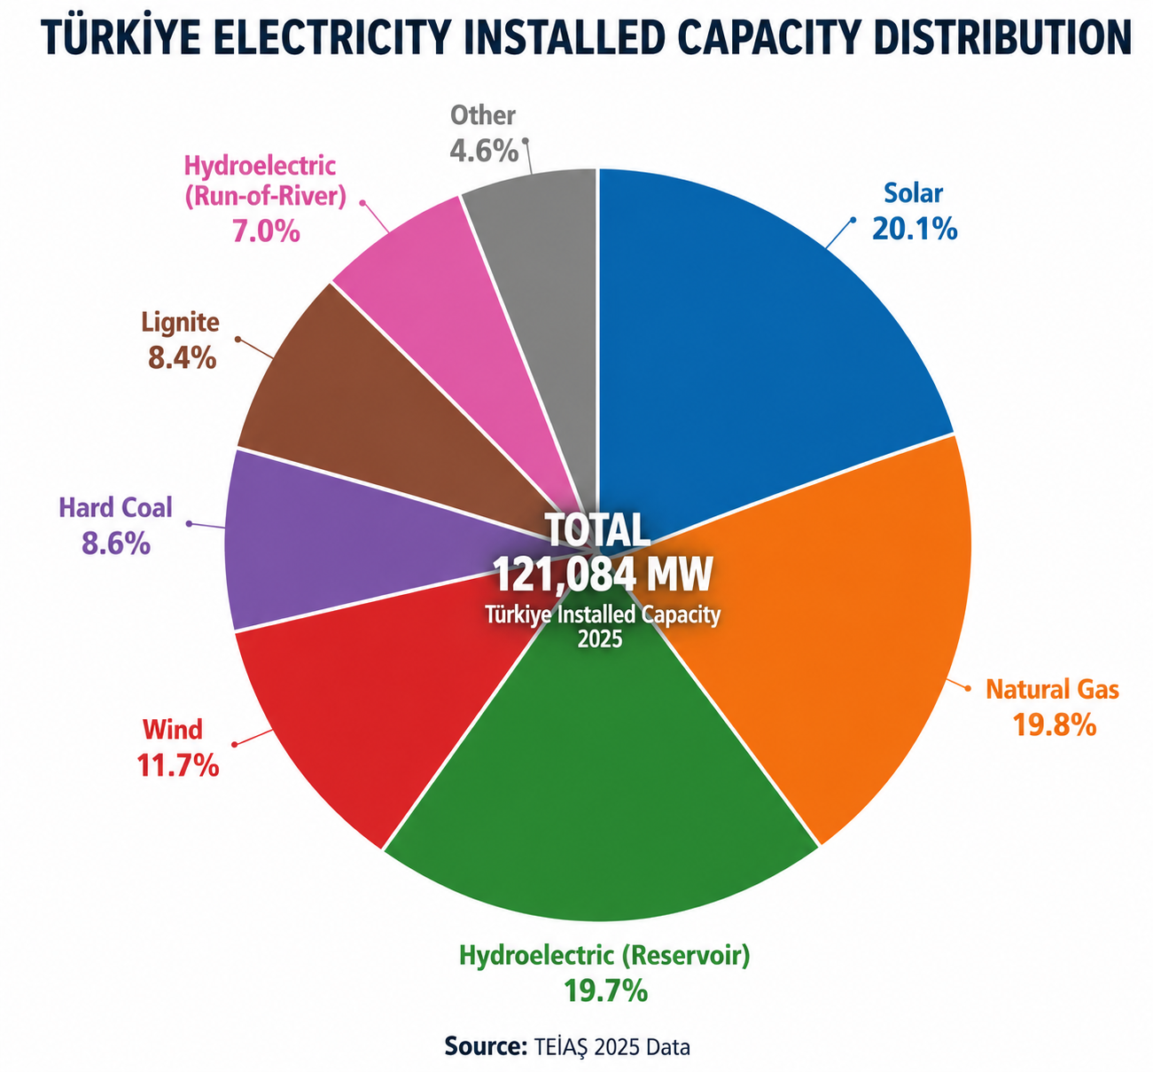
Turkey's Electric Energy Resources
Carbon-based and imported energy constitutes a risk factor in terms of Energy Security.

Slide 24
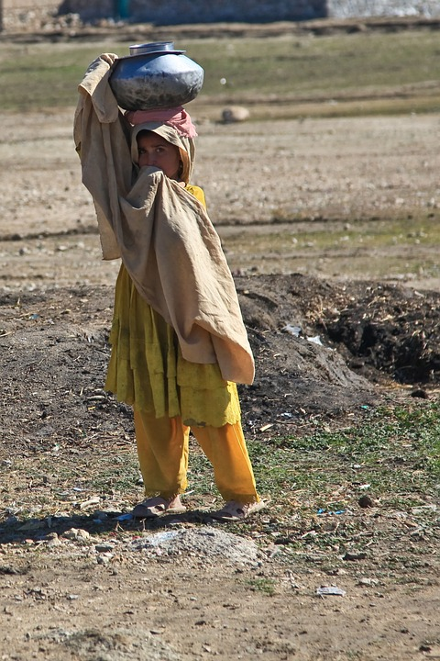
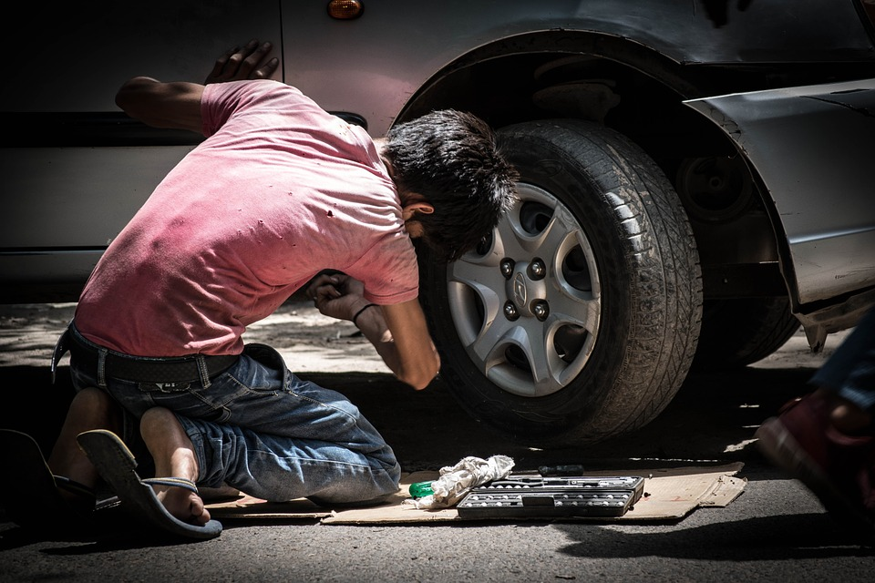
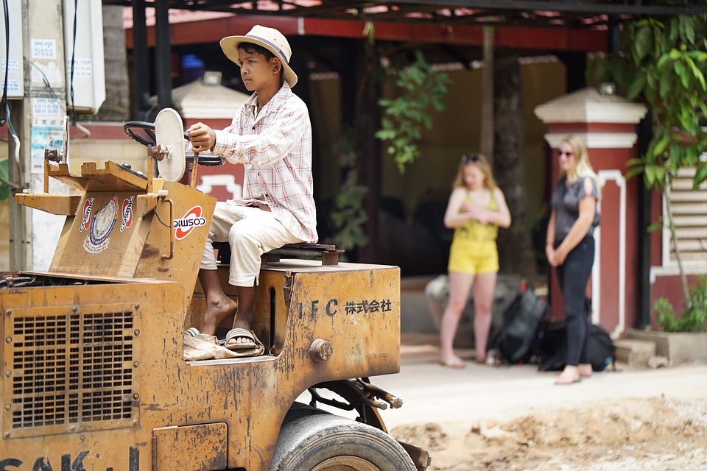
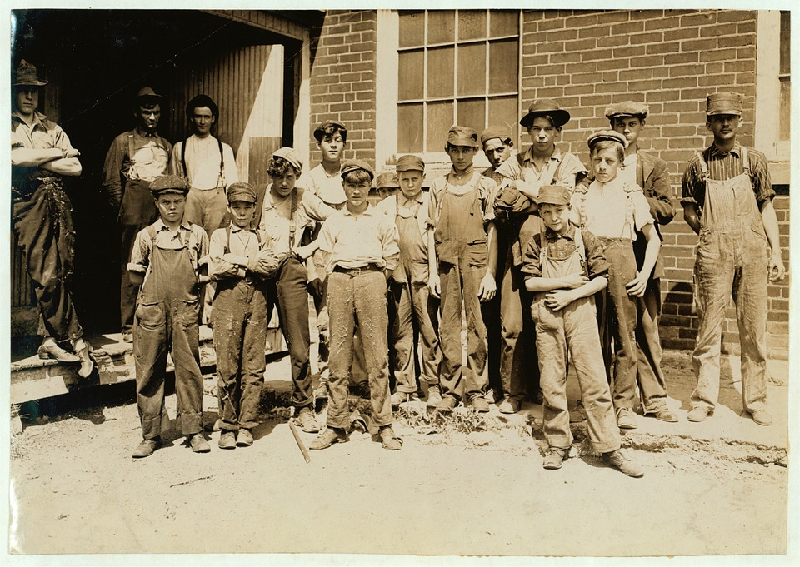
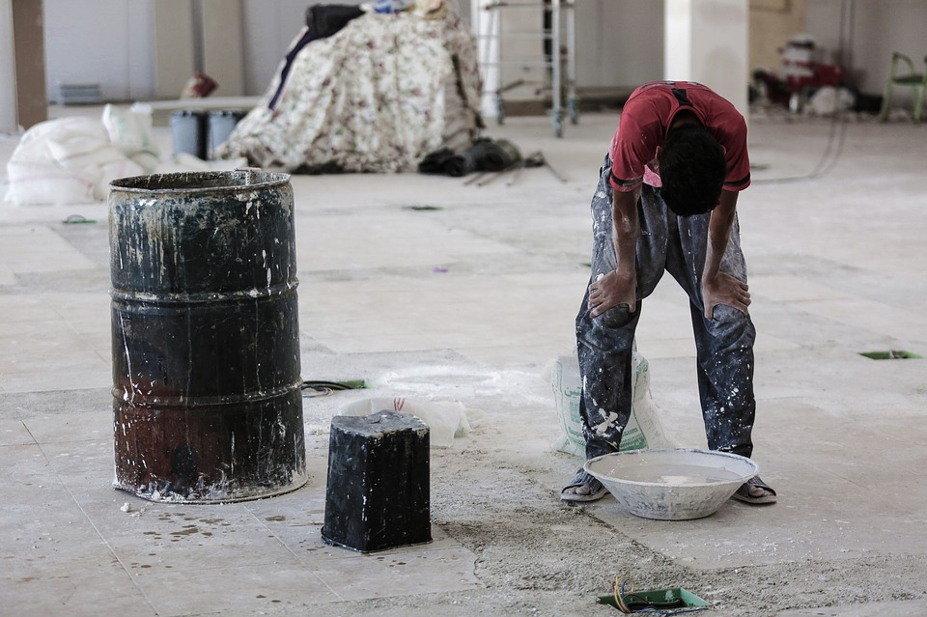
Global Issues: Women and Children's Rights
Women's and children's rights are protected by the law and international agreements.

Slide 25

What should be the Business World Perspective?
Sustainable Development
To balance the business world and the needs of human life with the sustainability of natural resources.
When doing this, to be behave responsible to employee and society and invest in their development.

Slide 26

GRI Global Reporting Initiative
NEW GRI STANDARDS
Non-profit NGO / Amsterdam
Sustainability Reporting
95% of the reporting people prefer
İÇDAŞ A.Ş. has been preparing the sustainability report in accordance with GRI standards since 2011.

Slide 27
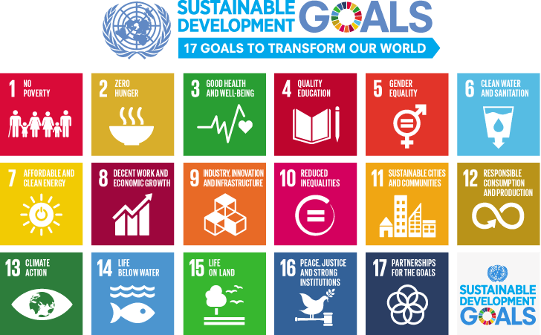
UN Sustainable Development Goals
İÇDAŞ A.Ş. has been reporting on activities that supporting the UN Sustainable Development Goals since 2016.
Notes:
2000 yılındaki BM konferansında 189 ülkenin katılımıyla Millenium Development Goals-Binyıl Kalkınma Hedefleri belirlenmiş ve 2015 yılına kadar ulaşılacak hedefler koyulmuştu.
2012 yılında gerçekleşen Rio+20 BM konferansında ise bu hedefler, 193 ülkenin katılımıyla, 2015 Sürdürülebilir Kalkınma Hedefleri olarak güncellendi.
Yoksulluk, tarım, kadın hakları, eğitim, iklim değişikliği, şehirleşme gibi başlıklarda belirlenen 17 hedefin 3 tanesi çevre ile ilgili…

Slide 28

Certification Authority for Reinforcing Steels (CARES)
Sustainable Steel Production
Fully Traceable Production
Reducing Risk in the Supply Chain
Continuous Improvement
İÇDAŞ A.Ş. has been continuing to produce sustainable steel production in accordance to CARES Sustainability Standards since 2011.

Slide 29



Other Initiatives
Calculation of Carbon Emissions
ISO 14064-1
Greenhouse Gas Emission
Verification Standard
GHG - Greenhouse Gas Emissions Protocol
İÇDAŞ A.Ş. has been watching greenhouse gases since 2003.

Slide 30
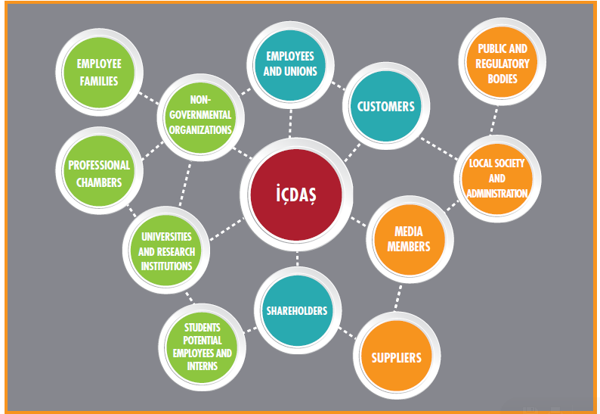
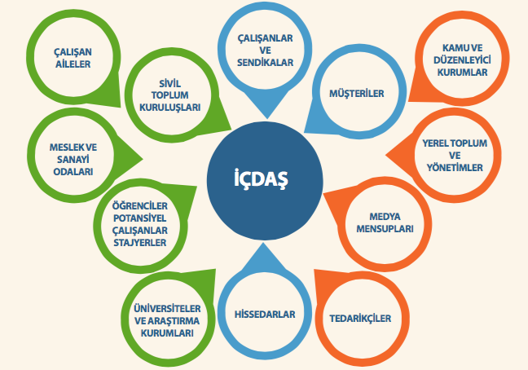
İÇDAŞ Stakeholder Map

Slide 31
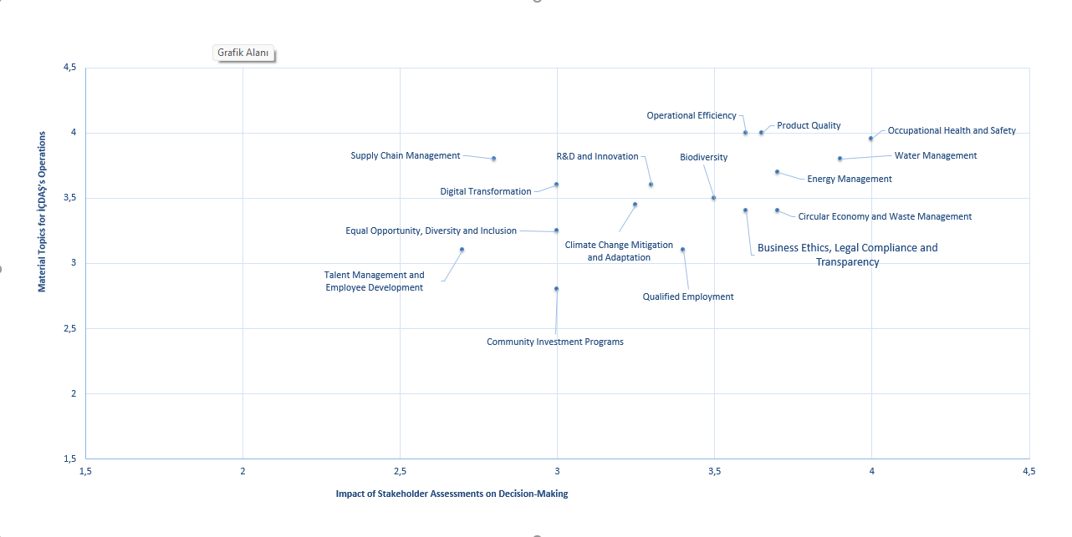
İÇDAŞ Strategic Sustainability Elements Matrix
We have identified the impact and importance our Strategic Sustainability Elements' influence on the stakeholders and company. We monitor and review these elements regularly.
Evaluation for the Year 2025

Slide 32
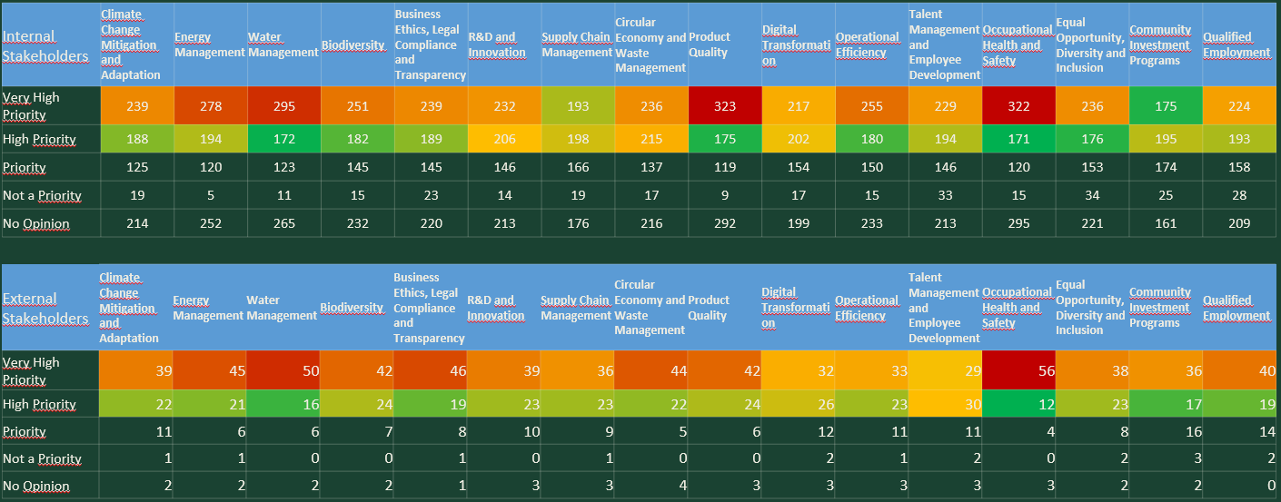
ICDAS Strategic Sustainability Elements Matrix

Slide 33
What brings sustainability to you?
Reduces threats and multiplies opportunities ...
More...
Effective
Profitable
Valuable
Reliable
Reputable
Prepares for the future…

Slide 34
SUSTAINABILITY POLICY
İÇDAŞ shares its commitments regarding Sustainability Policy with all its stakeholders on its website.
https://www.icdas.com.tr/pages/8967/4736/f/en-US/Policies.aspx

Slide 35
ICDAS ETHICAL PRINCIPLES POLICY
İÇDAŞ shares its commitments regarding İçdaş Ethical Principles Policy with all its stakeholders on its website.
https://www.icdas.com.tr/pages/8967/4736/f/en-US/Policies.aspx

Slide 36
ICDAS SUPPLY CHAIN COMPLIANCE POLICY
Through the ICDAS Supply Chain Compliance Policy, the organization shares its commitments regarding its expectations from suppliers with all stakeholders on its website, and these commitments are periodically communicated to all suppliers.
https://www.icdas.com.tr/pages/8967/4736/f/en-US/Policies.aspx

Slide 37
ICDAS ETHICAL PRINCIPLES POLICY
We would like to point out that İÇDAŞ has an "Internal and External Complaint Procedure" and "Suggestion and Complaint Form", which aims to guide the United Nations Business and Human Rights principles and is designed to include all stakeholders.

Slide 38
ICDAS ETHICAL PRINCIPLES POLICY
İÇDAŞ In accordance with the United Nations Business and Human Rights principles;
The mechanism for addressing internal and external complaints
The fair evaluation of complaints and the implementation of corrective actions.
Aiming for traceability and continuous improvement through actions.
Transparency, fairness, and the mitigation of social risks.

Slide 39
ICDAS ETHICAL PRINCIPLES POLICY
While we attach importance to channel diversity and accessibility in the complaint system;
Telephone
E-mail
Complaint forms
Through the İÇDAŞ website
All our stakeholders can reach us and establish the necessary communications.

Slide 40
İÇDAŞ HUMAN RIGHTS POLICY
Application Field
Complaints Recorded
Identify roles and responsibilities for complaints
Necessary actions are initiated
Finalized by Responsible Executives

Slide 41




İÇDAŞ HUMAN RIGHTS POLICY
0 212 604 04 04
icdas@icdas.com.tr
Complaint Form
İÇDAŞ, Contact Form (icdas.com.tr)

Slide 42


İÇDAŞ HUMAN RIGHTS POLICY
Complaints are responded to within 10 days of receipt
It is aimed to finalize complaints within 60 days.

Slide 43
ICDAS ETHICAL PRINCIPLES POLICY
An Ethics Line and Ethics Committee have been established for the investigation of adverse notifications related to ethical principles and social labour principles based on the ICDAS Code of Ethics Policy.
Our employees shall adopt ethical rules and shall not engage in any conduct contrary to these rules. Compliance with the ICDAS Code of Ethics shall be questioned in all activities carried out and decisions taken.
In cases of hesitation regarding compliance with the Code of Ethics, the communication channels of the Ethics Line shall be consulted. Confidentiality is essential in all applications.
Violations of the Code of Ethics are evaluated by the Ethics Committee and, where necessary, by the Disciplinary Committee, and disciplinary sanctions up to and including termination of employment may be imposed on those who commit violations.
Note: All details are included in the ICDAS Ethical Principles Policy.

Slide 44
ICDAS ETHICAL PRINCIPLES POLICY
Ethics Line
Ethics Notification Line on the Website: www.icdas.com.tr
E-mail Address: etik@icdas.com.tr
WhatsApp Ethics Line: +90 533 790 19 19
Ethics Line: +90 533 790 19 19
Ethics Line Notification Boxes
There is no obligation to disclose identity when making notifications to the Ethics Line. The identity of the person making the notification shall, in all circumstances, be kept confidential and shall not be disclosed under any condition.

Slide 45
ICDAS ETHICAL PRINCIPLES POLICY
Ethics Committee
The Ethics Committee, operating under the ICDAS Board of Directors, consists of one Chairperson and four members. The Chairperson and members of the Committee are appointed by the Board of Directors. The Chairperson of the Committee is an Independent Member of the ICDAS Board of Directors, and the Deputy Chairperson is the Legal Counsel. The Ethics Committee consists of the following members:
Independent Member of the Board of Directors
Legal Counsel
Human Resources Manager
Audit, Risk Management and Internal Control Manager

Slide 46
ICDAS ETHICAL PRINCIPLES POLICY
Ethics Committee
The Chairperson and members of the Ethics Committee shall perform their duties independently from their respective Department Managers and the hierarchy within the organization, without being influenced, and in accordance with the principles of integrity, objectivity, and confidentiality. The working procedures and methods of the Ethics Committee shall be determined through a published procedure. The duties of the Ethics Committee are as follows:
To resolve conflicts of interest arising within the scope of the Code of Ethics,
To evaluate notifications submitted through the Ethics Line regarding alleged violations of the Code of Ethics,
To provide recommendations regarding the methods, procedures, and practices to be followed in cases of ethical violations,
To submit reports to the Board of Directors every three months regarding ethical violations and measures taken, to submit an annual activity report, and to follow the instructions issued in relation to such matters.

Slide 47


Ethical Violation Notification
+90533 790 19 19
+90533 790 19 19
etik@icdas.com.tr
Ethics Line Notification Boxes
İÇDAŞ – Etik Hat Bildirimi

Slide 48
SOCIAL RESPONSIBILITY MANUAL
Our company's social responsibility manual was prepared to raise the awareness of our employees and to achieve our sustainability goals.
All manuals are accessible to all employees in the QDMS system we use for document management.

Slide 49


Slide 50













Sustainability reports have been prepared since 2011 are published on our website. https://www.icdas.com.tr/pages/4736/4736/f/en-US/Sustainability.aspx

Slide 51


START CHANGING THE FUTURE THROUGH SUSTAINABILITY.....
THANK YOU

